Slide 1
UCSD Embedded C Final Project
By
Hsuankai Chang
hsuankac@umich.edu

Slide 2
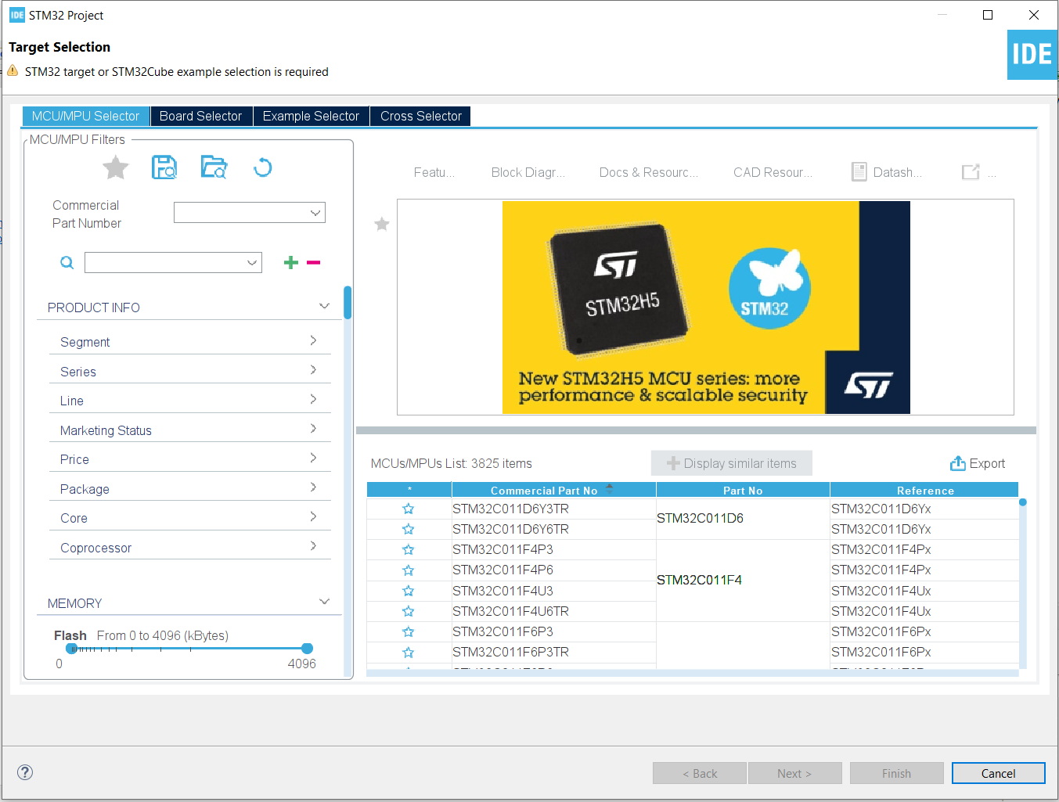
Step 1. Startup STM32CubeIDE and create new STM32 project

Slide 3
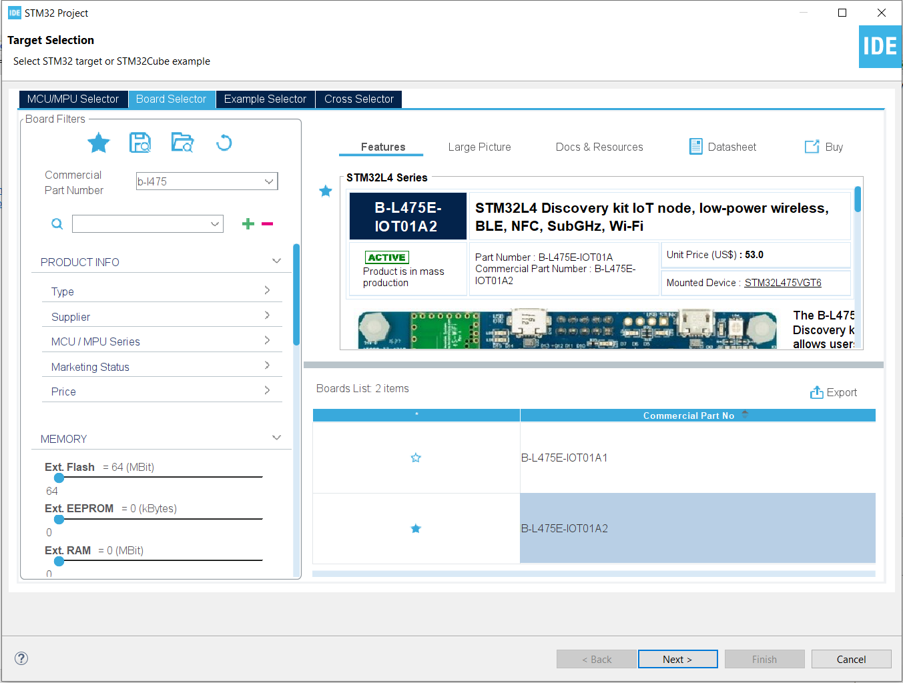
Step 2. Access board selector and type in the board you use, click Next

Slide 4
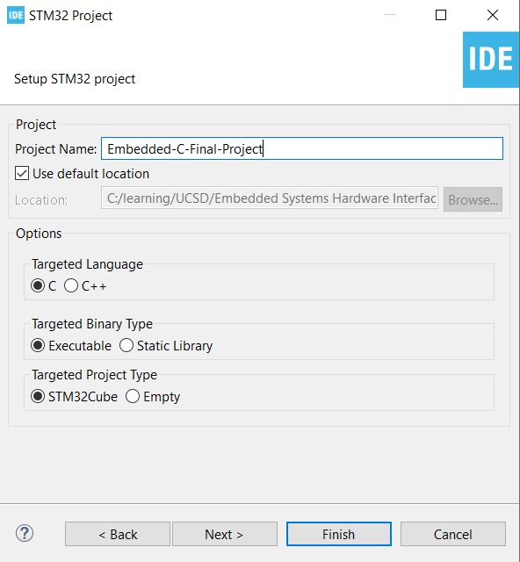
Step 3. Enter the project name then click Next

Slide 5
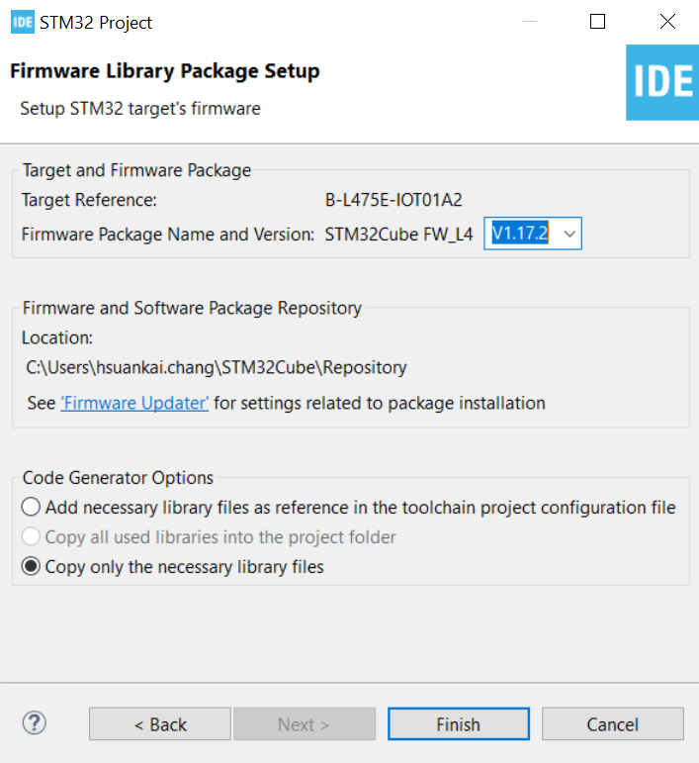
Step 4. See the firmware package name, version and location

Slide 6
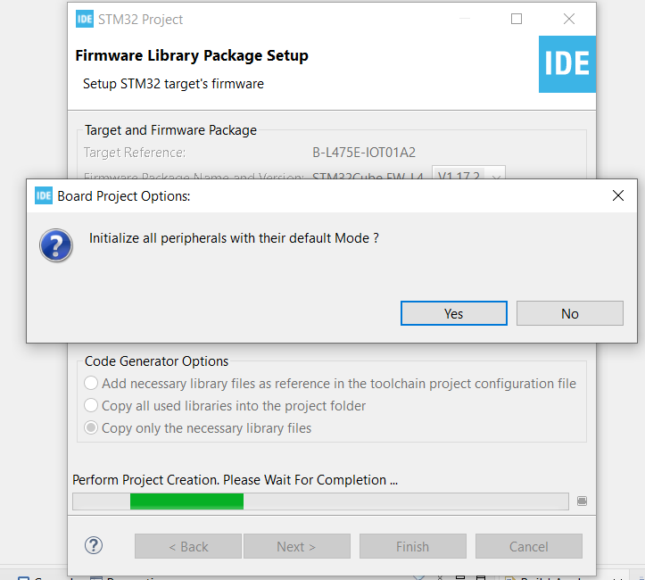
Step 5. Click yes to initialize all peripherals to default

Slide 7
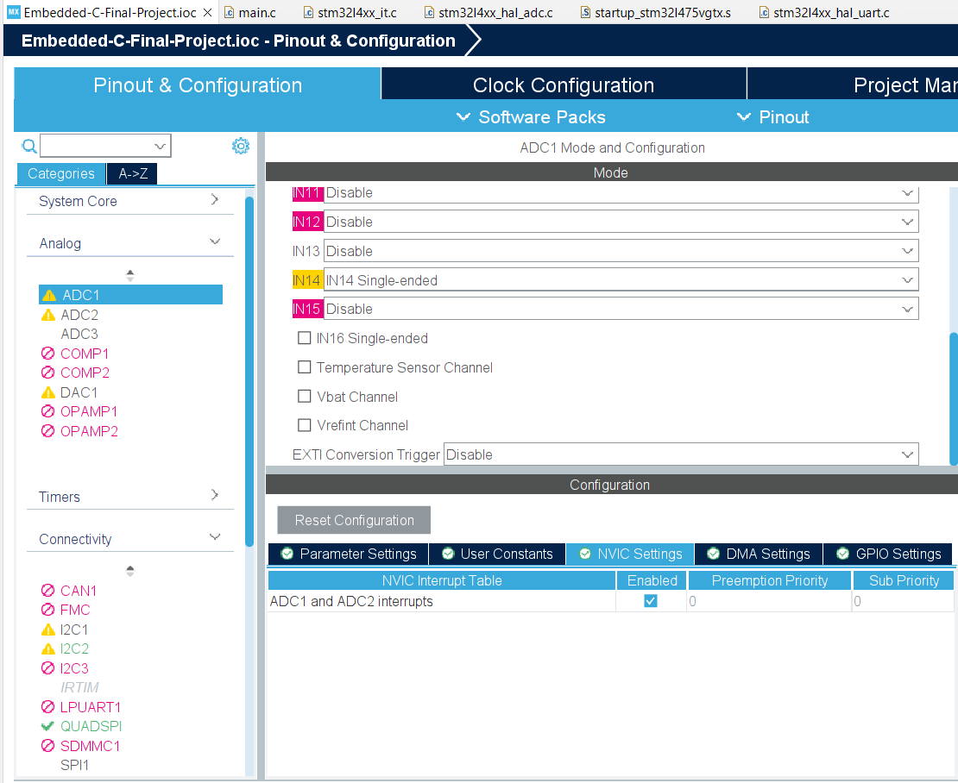
Step 6. In the final project, I decide to demonstrate ADC reading in polling and interrupt mode, I2C temperature reading with HST221 using polling, interrupt and DMA mode, also using UART to transmit and receive message, and GPIO to toggle the LED pin. First start to enable ADC settings

Slide 8
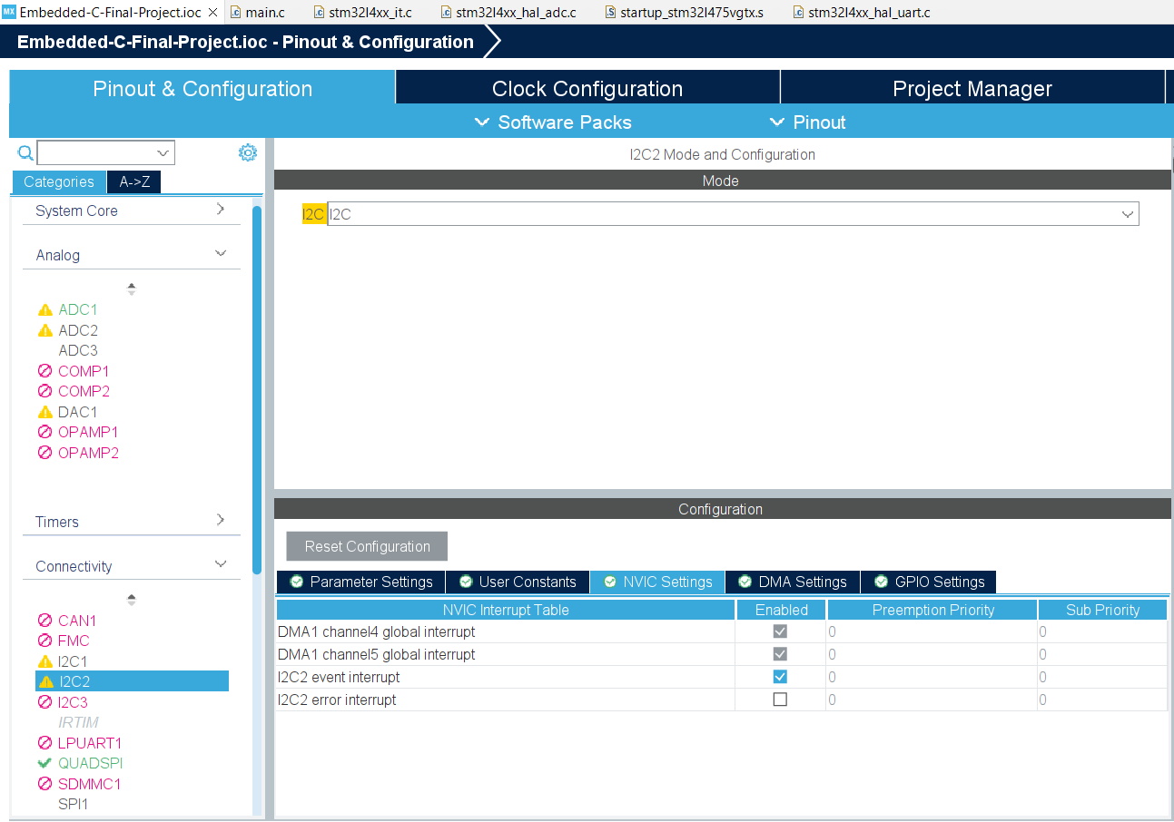
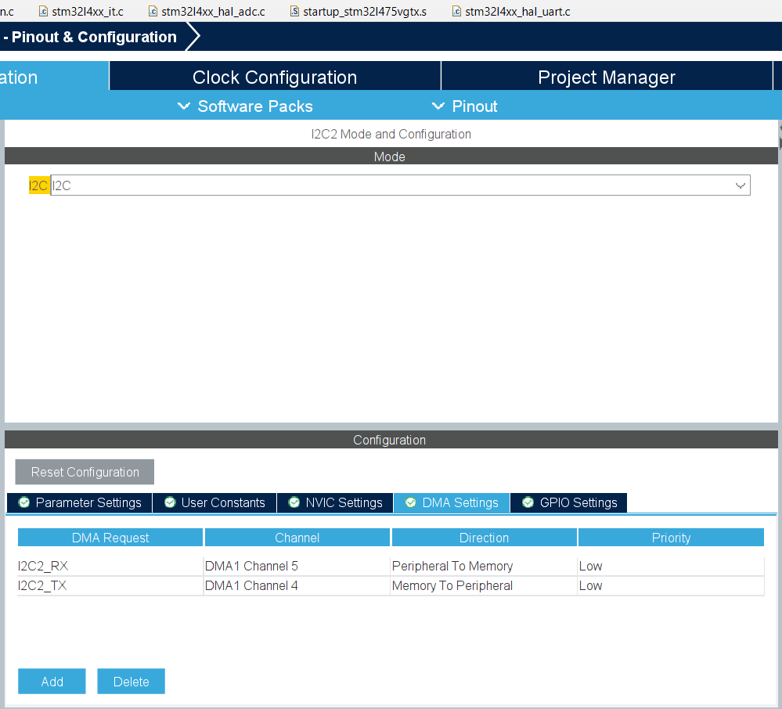
Step 7. Next, start setting up the I2C, notice that I set up both the interrupt and DMA mode

Slide 9
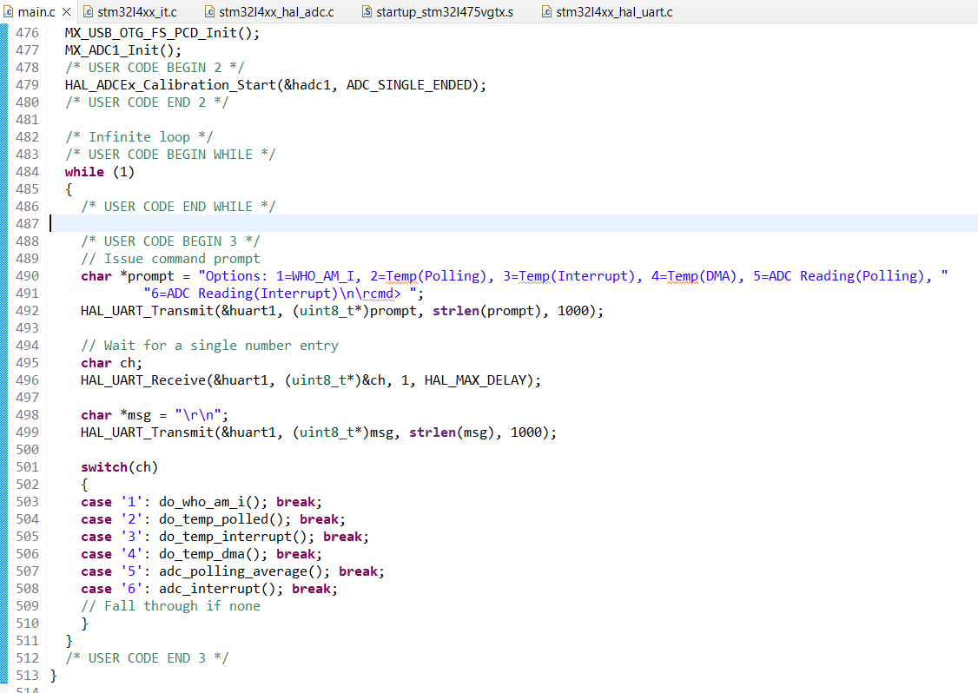
Step 8. Start coding the command line interface using UART

Slide 10
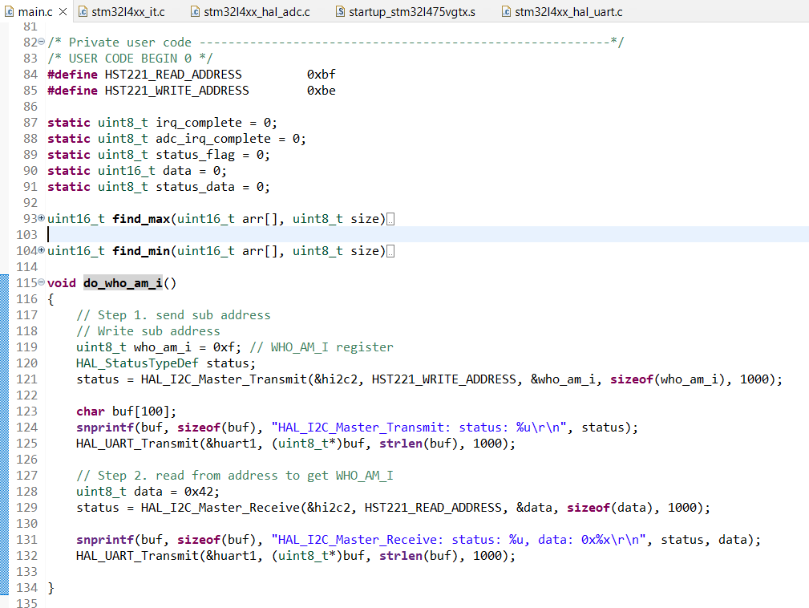
Step 9. Start to code up the I2C who am I register reading

Slide 11
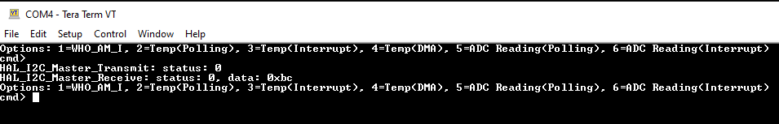
Step 10. Build and test the function, test is successful

Slide 12
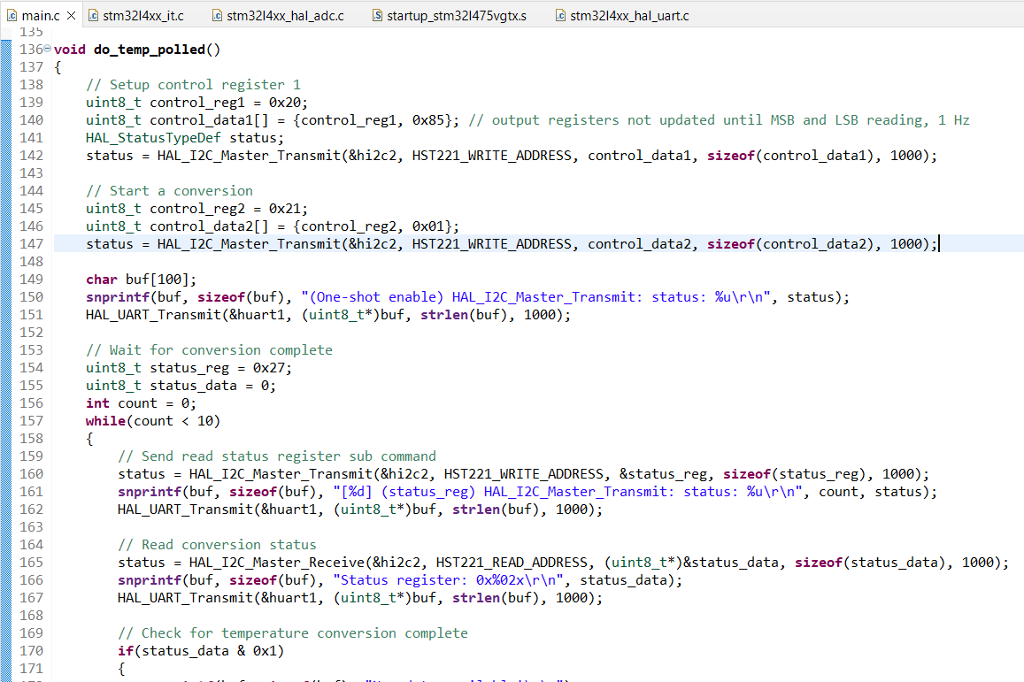
Step 11. Start coding the I2C reading in polling mode

Slide 13
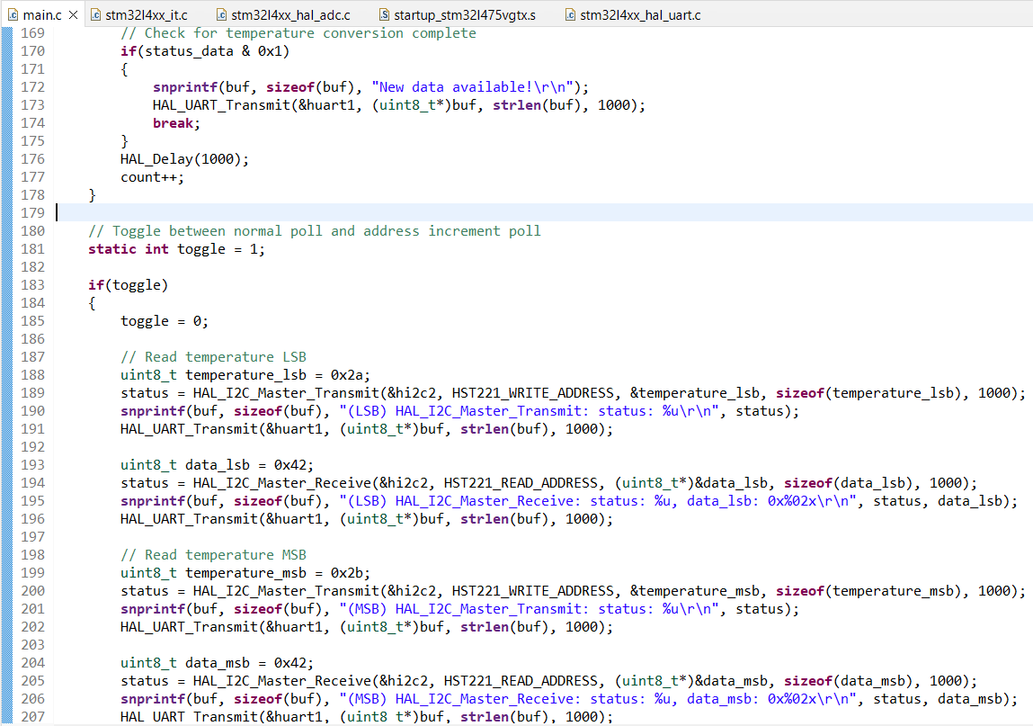
Step 12. I2C temperature reading code continue, notice like just in assignment, I toggle between one-shot and auto increment mode

Slide 14
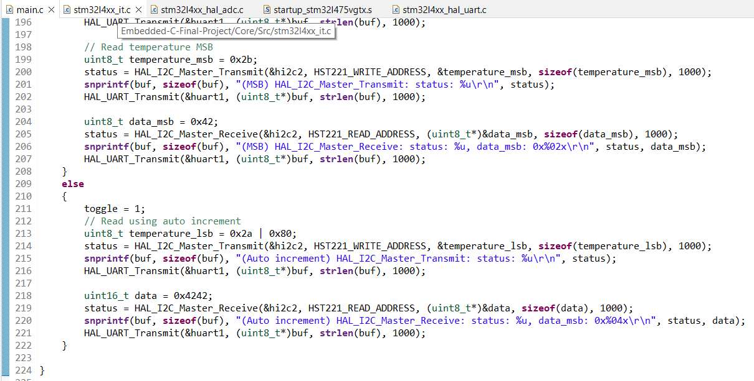
Step 13. I2C polling continue

Slide 15
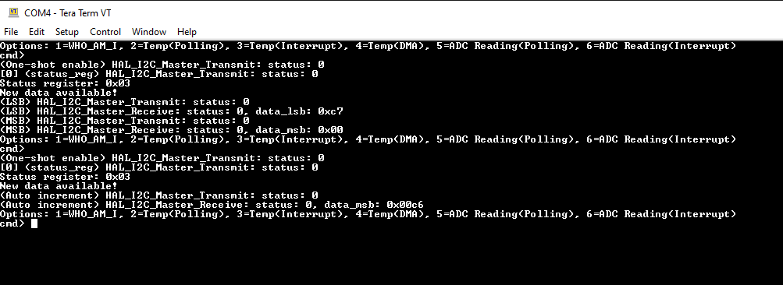
Step 14. Test the I2C polling, test is successful

Slide 16
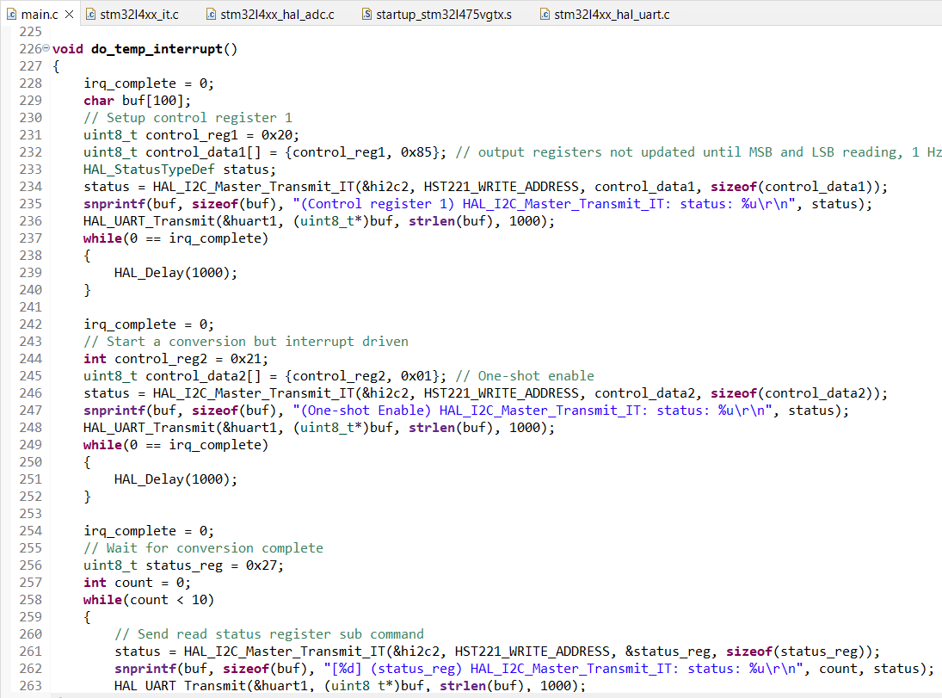
Step 15. I2C temperature reading interrupt mode coding

Slide 17
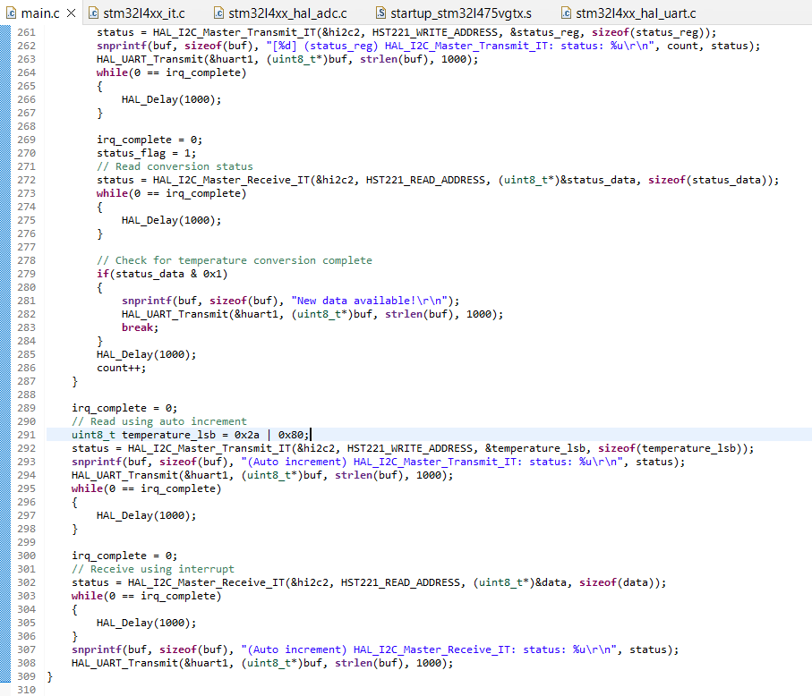
Step 16. I2C temperature reading interrupt mode coding continue

Slide 18
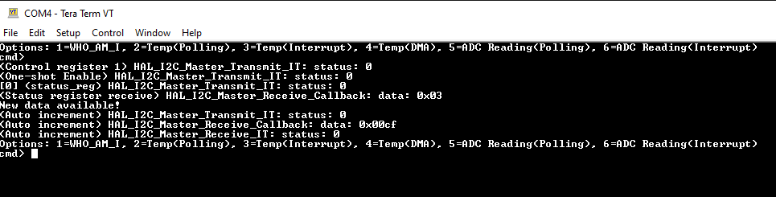
Step 20. Test the code, test is successful

Slide 19
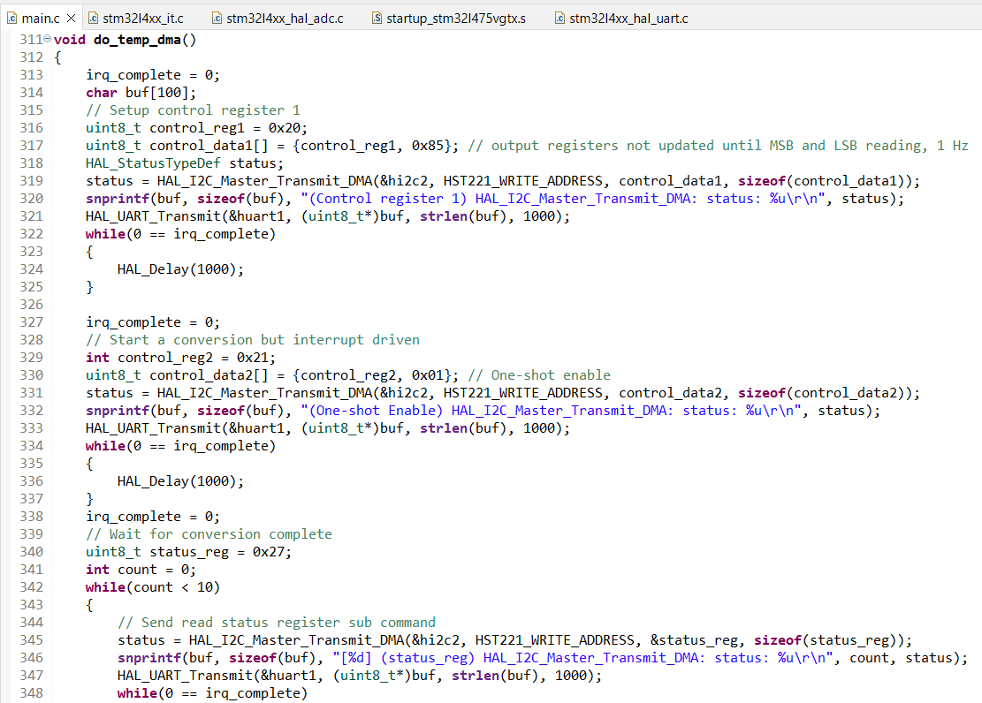
Step 18. I2C temperature reading DMA mode coding

Slide 20
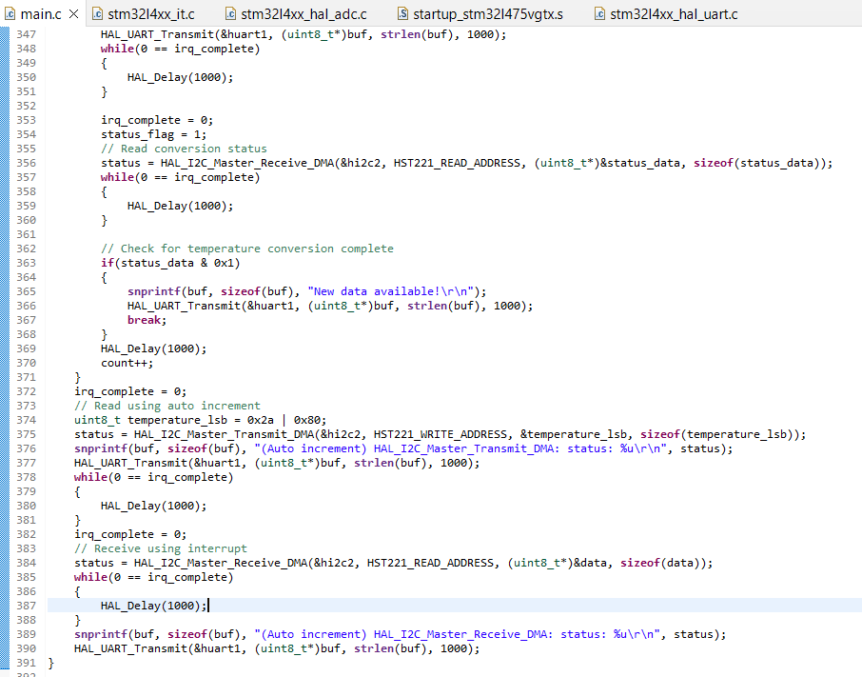
Step 19. I2C temperature reading DMA mode coding continue

Slide 21
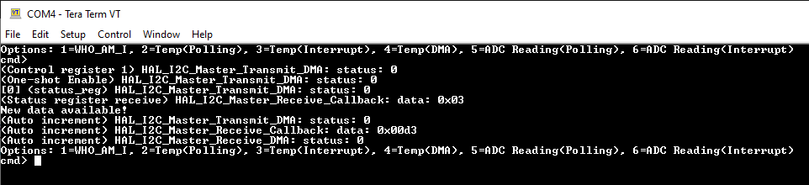
Step 20. Test the code, test is successful

Slide 22
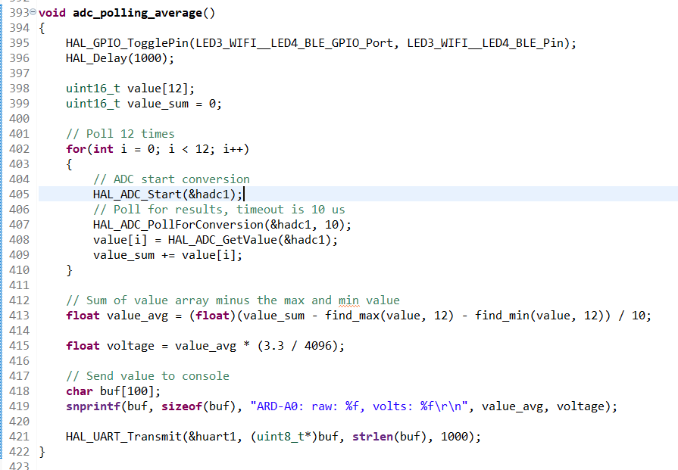
Step 21. ADC polling reading coding

Slide 23
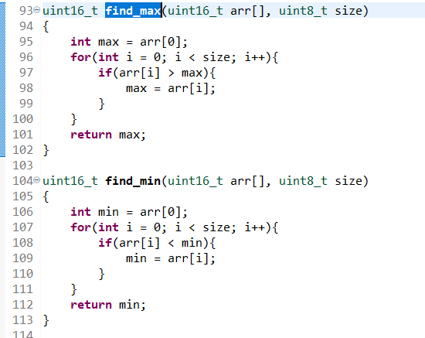
Step 21. ADC polling reading coding continue, find max and min function

Slide 24
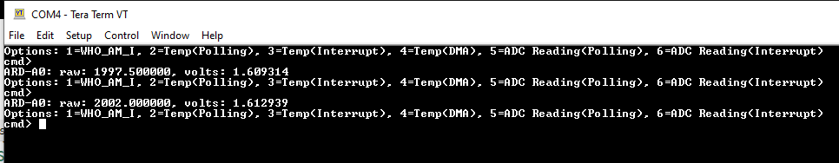
Step 22. Test the code, test is successful

Slide 25
Step 22. Test the code, test is successful

Slide 26
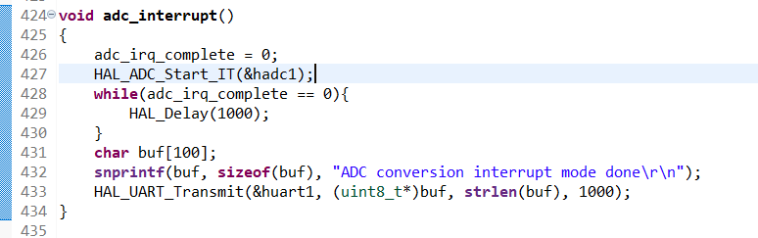
Step 23. ADC interrupt coding

Slide 27
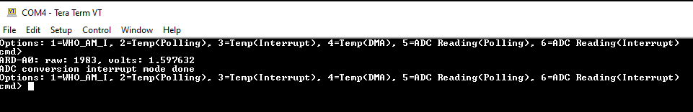
Step 24. Test the code, test is successful

Slide 28
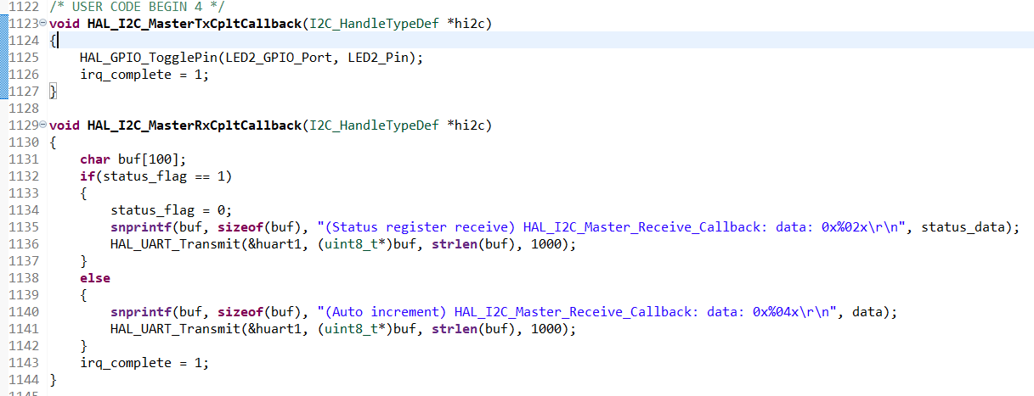
Step 25. Interrupt call back function implementation for I2C

Slide 29
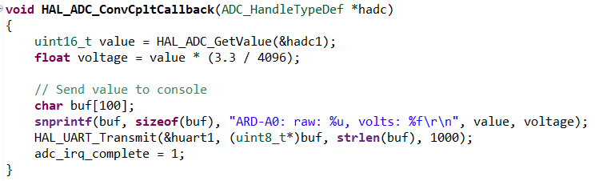
Step 26. Interrupt call back function implementation for ADC

Slide 30
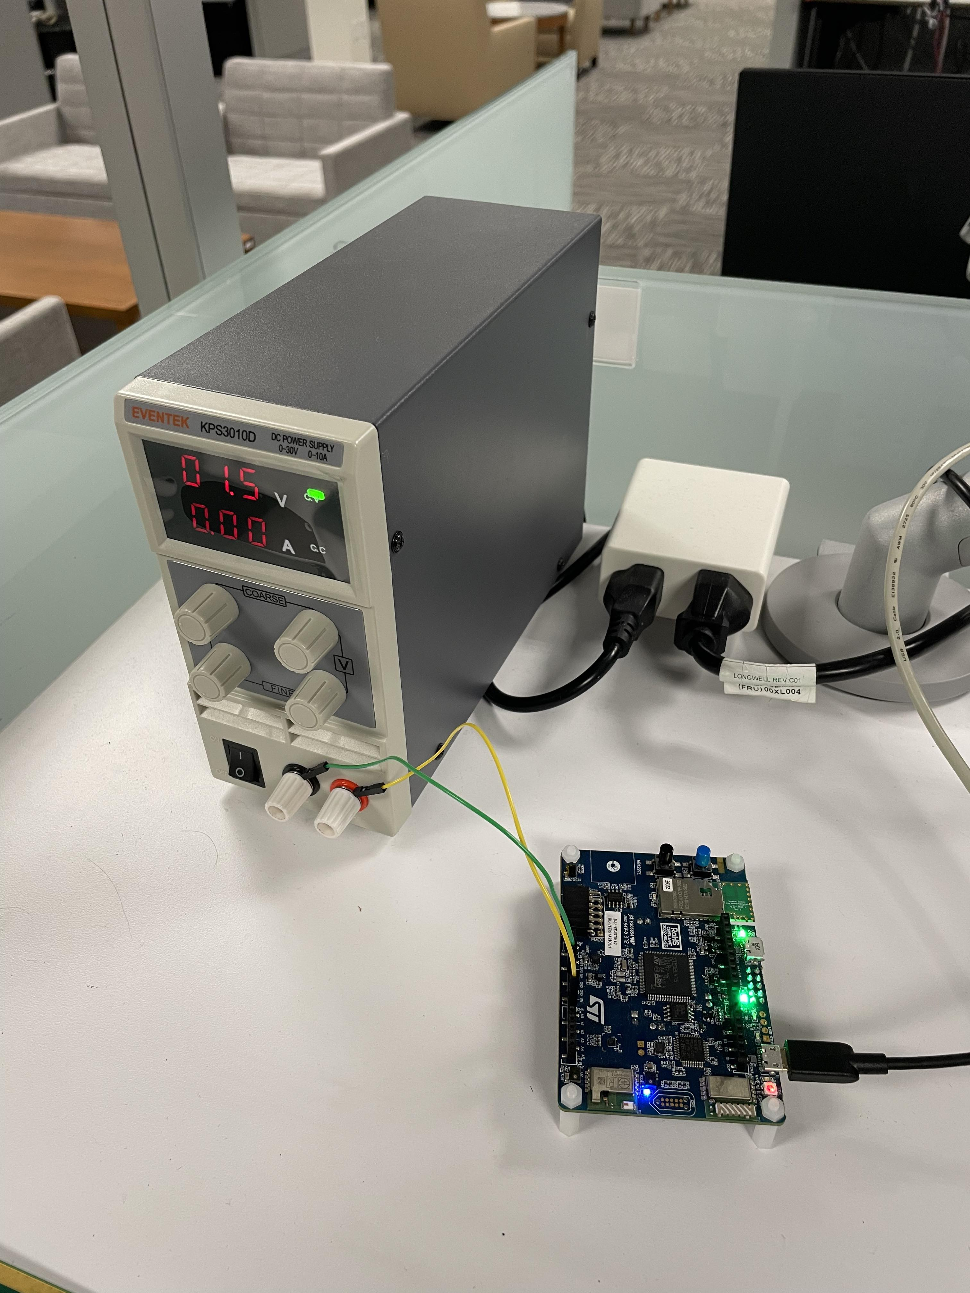
Appendix, wire connection to ARD-A0 pin with 1.5V, note that we actually read 1.6v, since the power supply is not very accurate

Slide 31
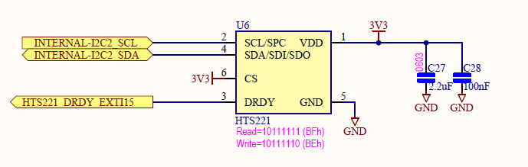
Appendix, schematic for HTS221

Slide 32
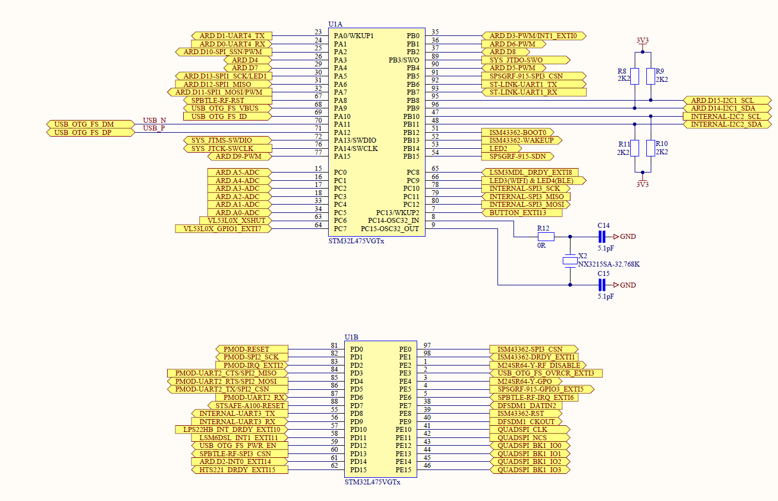
Appendix, schematic for processor side

Slide 33
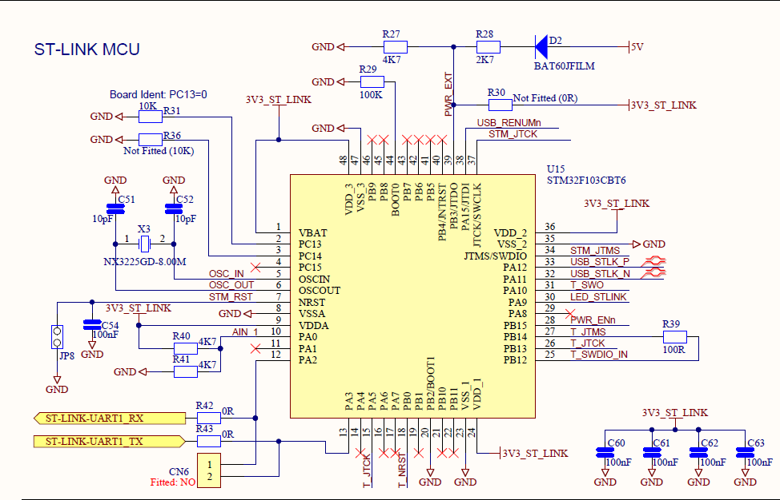
Appendix, schematic for ST-LINK UART1

